Slide 1
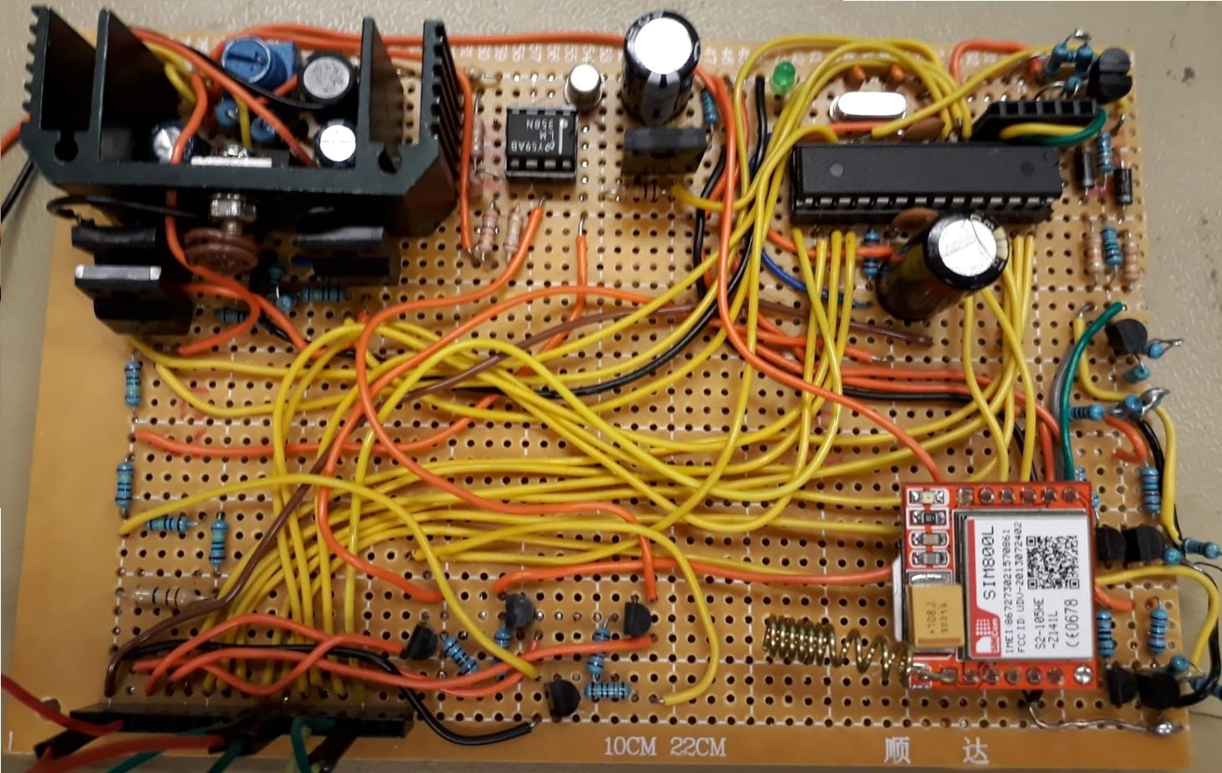
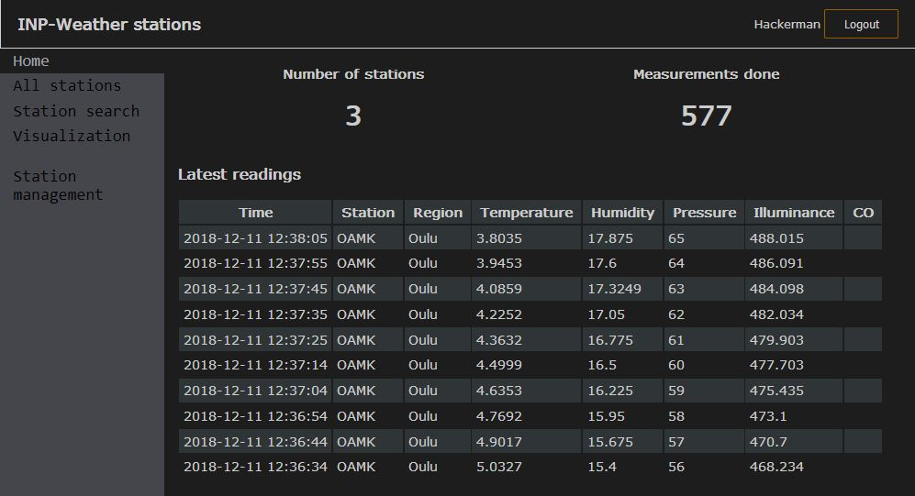
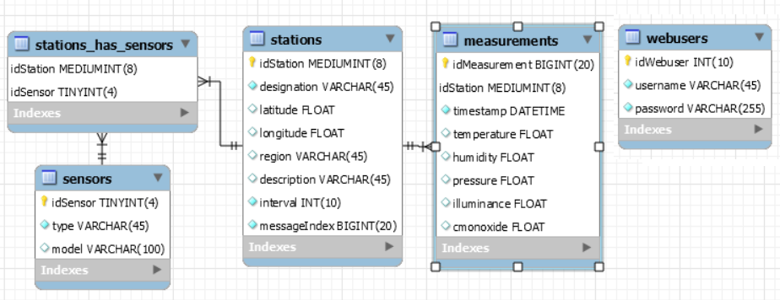
Poster Template
Santtu Nyman TVT17SPL
Information & Communication Technology, Product and Device Design
Objective
Project aimed to create a something able to stay operational for one year or something about database.
Methods
The purpose of the website is to act as a proxy that listens POST requests sent by different stations. Requests are processed and measurements then inserted into database. HMAC authentication for messages is implemented but not used because the memory limitations on station side.
Results
Integrating the sensors with the controller board proved problematic and the process was still ongoing with only few days before the deadline. Ultimately issues were resolved and integration was successful
Figure 2. Front page displaying latest readings and statistics
Figure 3. Different tables in database.
Figure 1. Weather station board.
ECTS credits: 15
Date of publication: 2020, Spring
Instructor: Kari Jyrkkä

